Slide 1
Module Title:
MACHINE LEARNING
Module Code:ITLML801
Competence:
MACHINE LEARNING MODULE DESCRIPTION
Learning hours:100
Trainer: Mr. IRABARUTA Emmanuel

Slide 2
Data Pre-Processing
Introduction to Data Analysis
Importing the data Summarizing the Dataset Data Visualization Exporting the data
Data Wrangling
Exploratory Data Analysis (EDA
COTENTS
Objectives Introduction

Slide 3
.
Objectives
To understand the concepts of Data Preprocessing and Data Analysis.
To understand the fundamentals of dataset and downloading from the website.
To understand the python code for preprocessing of data.
To understand the process of data wrangling with examples.
To know the different aspects of exploratory data analysis.

Slide 4
Introduction:
Data preprocessing is a process of preparing the raw data and making it suitable for a machine- learning model.
It is the first and crucial step while creating a machine-learning model because the real world data generally contains noises, missing values and may be in an unusable format, which cannot be directly used for machine learning model.

Slide 5
Introduction:
Hence, the data preprocessing is required tasks for cleaning the data and making it suitable for a machine-learning model, which also increases the accuracy and efficiency of a machine-learning model.
In this unit, we will discuss and understand the fundamentals of data preprocessing and the necessary steps and approaches in doing the preprocessing. Also, we explore the concept of data analysis and we try to understand how the data wrangling and exploratory data analysis helps for effective data preprocessing.

Slide 6
3.1 INTRODUCTION TO DATA ANALYSIS
Data analysis plays a crucial role in processing data in making them as useful information.
Data analysis is the process, which includes cleaning the data, changing the data and processing raw data and extracting relevant information that helps for machine learning.
We cannot preprocess effectively unless we understand better about the data given to us.
Hence, the data analysis became important in the approach of data preprocessing. The process of data analysis consists of the following steps.

Slide 7
1. Gathering the Requirement for Data: This helps you to decide the need for the data, what type of data you want to use, and what data you plan to analyze.
2. Data Collection: It’s time to collect the data from your sources. Data collection will be done from your identified requirements.
3. Data Cleaning: It’s time to clean up the collected data. Assume that some of your collected data is useful and some of data is not useful

Slide 8
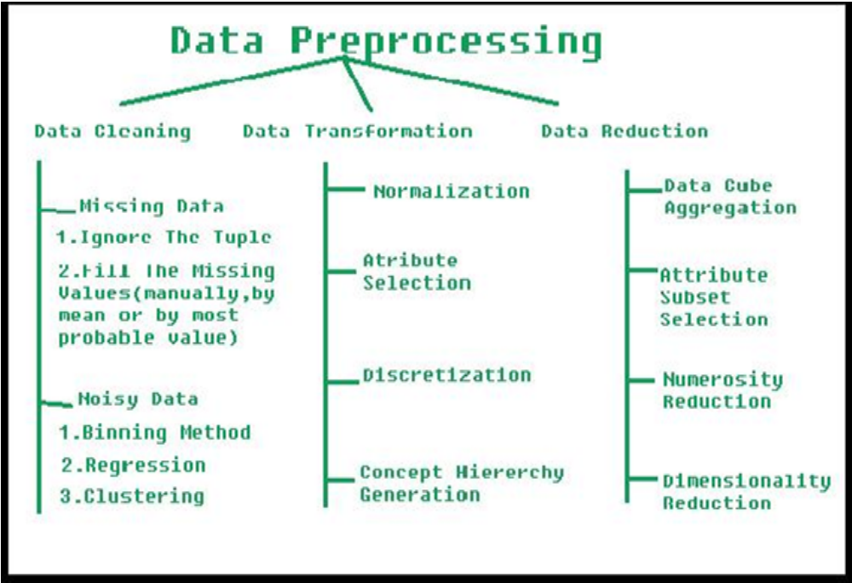

Slide 9
This process is where you remove white spaces, duplicate records, and basic errors. Data cleaning is mandatory before sending the information for data analysis.
1. Data Analysis: You will understand the data better and better in all the possible ways. You can also use tools, which includes Excel, Python, R, Rapid Miner and etc. You will create many graphs / diagrams as the outcome of your data analysis.
2. Data Interpretation: Assume that you have your data analysis results. Now, you need to interpret them and come up with the best courses of action based on your findings.

Slide 10
3. Data Visualization: This is a fancy way of saying like “graphically show your information in a way that people can read and understand it.” You can use charts, graphs, maps, bullet points, or other methods.
There are few more types, which are commonly used in the worlds of technology and business and the same is given below.

Slide 11
Diagnostic Analysis: This answers the question, “Why did this happen?” Ideally, the analysts find similar patterns that existed in the past, and consequently, use those solutions to resolve the present challenges hopefully.
Predictive Analysis: This answers the question, “What is most likely to happen?” By using patterns found in older data as well as current events, analysts predict future events.
Prescriptive Analysis: Mix all the insights gained from the other data analysis types, and you have prescriptive analysis. Sometimes, an issue can’t be solved solely with one analysis type, and instead requires multiple insights.

Slide 12
Statistical Analysis: This answers the question, “What happened?” This analysis covers data
collection, analysis, modeling, interpretation, and presentation using dashboards.
Text Analysis: Also called “data mining,” text analysis uses databases and data mining tools to discover patterns residing in large datasets.
It transforms raw data into useful business information. Text analysis is arguably the most straightforward and the most direct method of data analysis.

Slide 13
Although there are many data analysis methods available, they all fall into one of two primary types of data analysis. They are qualitative analysis and quantitative analysis.
The qualitative data analysis method derives data via words, symbols, pictures, and observations. This method doesn’t use statistics.
But, the Quantitative Data Analysis produces different numbers as the result of data analysis with the help of statistical methods. Statistical data analysis methods collect raw data and process it into numerical data.

Slide 14
3.2 IMPORTING THE DATA
For our practice, we can load the data directly from the UCI Machine Learning repository (https://archive.ics.uci.edu/ml/index.php).
This data /dataset can be imported into python using pandas as shown below.
The dataset downloaded is known as “Pima Indian Dataset” using the following steps.
Step 1 Declaring the Pandas Library
Step 2 File is assigned to a variable name
Step 3 Assigning the Columns Names or Column Headings.
Step 4 Importing the PIMA Dataset ( File Name is pima_indians.csv ) Observe the following code for importing the dataset using python.

Slide 15
import pandas
data = ‘pima_indians.csv’
names = ['Pregnancies', 'Glucose', 'BloodPressure', 'SkinThickness', 'Insulin', ‘Outcome’] dataset = pandas.read_csv(data, names=names)

Slide 16
3.3 SUMMARIZING THE DATASET
The dataset may be understood by the following observations. It is also known as summary of the dataset.
Observations are given in the bulletins.
• Basic Information about the dataset is obtained from the following code. print(dataset.info ())
• Dimensions of Dataset can be obtained using the following code. print(dataset.shape)
• Listing all top 10 data, the following code helps. print(dataset.head(10))
• Listing all bottom 10 data, the following code helps. print(dataset.tail(10))
• View the Statistical Summary from this code. print(dataset.describe())

Slide 17
3.4 Data Visualization
Data visualization is the process of representing data using visual elements like charts, graphs, etc.
The data can be better understood if we provide and summarize using the beautiful diagrams, which is known as data visualization.
There are two types of plots exists and used for data visualization. They are univariate and multivariate.

Slide 18
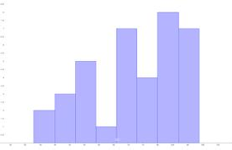
Univariate: Here, 'uni' means one and ‘variate’ indicates a variable. Therefore, univariate plot is a form of diagram / graph that only involves single variable.
You can use the following code for this purpose. import pandas
import matplotlib.pyplot as plt data = 'iris_df.csv'
names = ['sepal-length', 'sepal-width', 'petal-length', 'petal-width', 'class'] dataset = pandas.read_csv(data, names=names)
dataset.plot(kind='box', subplots=True, layout=(2,2), sharex=False, sharey=False)
plt.show()

Slide 19
2. Multivariate Plots Multivariate plots help us to understand the interactions between the variables.
For example, we look at different variables (or factors) and how they might impact certain situations or outcomes
Consider the marketing scenario, you might look at how the variable_1i.e., “money spent on advertising” impacts the variable_2 i.e., “number of sales”.
Here, we are considering two variables for the analysis and the same is put up in the visualization

Slide 20
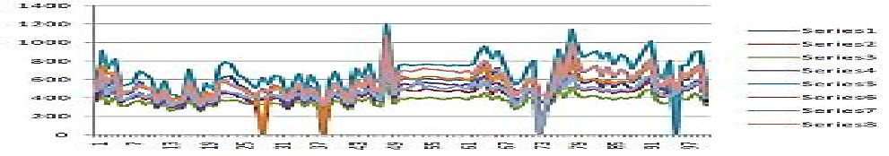
.

Slide 21
3.5 Exporting the data
After the data preprocessing is completed, we need to store the updated / modified data into the hard drive permanently.
For example, the data should move from the python Jupyter to Hard Disk.
The most common format is a csv file or excel file.
The built in functions to_csv() and to_excel() of
pandas can be used in order to export data

Slide 22
Exporting data as a csv file
df.to_csv('C:/Deva/MyDataset1.csv’)
• Exporting data as a excel file
df.to_excel('C:/Deva/MyDataset1.csv ')
Consider the code for creating a dataframe and exporting the contents into permanent file.
import pandas as pd
data = {'product': ['computer', 'tablet', 'printer', 'laptop'], 'price': [850, 200, 150, 1300]}
df = pd.DataFrame(data)
df.to_csv('C:\MyFolder\MyFile1.csv', index=False, header=True)
print(df)

Slide 23
3.6 DATA WRANGLING
Data wrangling is one of the most important tasks in Machine Learning and also in data science.
The process of gathering, collecting and transforming the original / raw data into another format is called data wrangling.
This is made for better understanding, better decision-making, better accessing and better analysis in less time.
There are few concepts that can help for effective data wrangling.

Slide 24
# Import pandas package
import pandas as pd
# Assign data
data = {'Name': ['Jai', 'Princi', 'Gaurav','Anuj', 'Ravi', 'Natasha', 'Riya'],'Age': [17, 17, 18, 17,
18, 17, 17],'Gender': ['M', 'F', 'M', 'M', 'M', 'F', 'F'],'Marks': [90, 76, 'NaN', 74, 65, 'NaN', 71]}

Slide 25
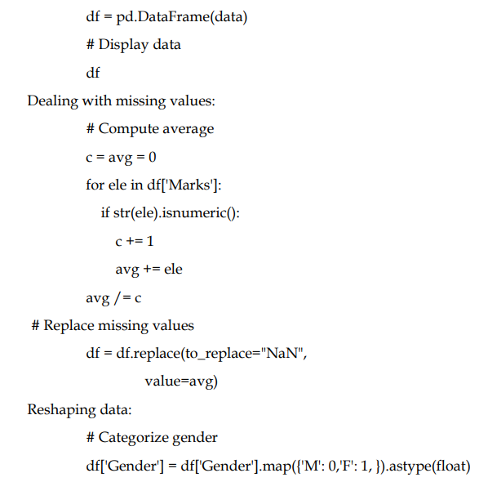

Slide 26
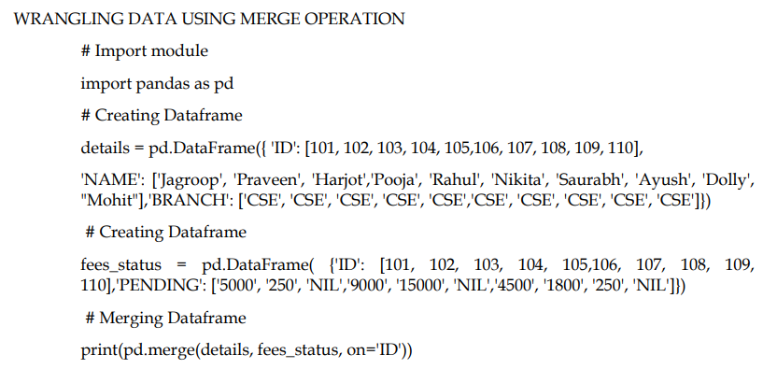

Slide 27
3.7 EXPLORATORY DATA ANALYSIS
This concept is used by data scientists to analyze and investigate the datasets.
They will summarize the important characteristics of the dataset using data visualization methods.
This analysis will make data scientists very easy and comfortable to discover some new patterns, spot anomalies in the existing patterns, test their hypothesis and etc.,The main purpose of EDA is to help look at data before making any assumptions

Slide 28
Review Questions
1. Explain the importance of data analysis.
2. Give the different approaches for data cleaning.
3. Differentiate univariate and multivariate analysis with examples.
4. Why data wrangling is used? Give the various steps involved in this.
6. How to remove the duplicate entries from the dataset?
7. Illustrate the fundamentals of exploratory data analysis.
8. Give the types of exploratory data analysis.

Slide 30
HANDLING MISSING VALUES:
Handling missing values in machine learning is an important preprocessing step that is essential for building accurate and reliable models.
Missing values can occur for various reasons, such as data entry errors, sensor failures, or simply because certain data points were not collected.

Slide 31
Here are some common strategies for handling missing values in machine learning:
1. Deletion: The simplest approach to handling missing values is to remove the rows or columns that contain them.
This can be done using the following techniques:
  Listwise deletion: This involves removing any row that contains a missing value.
  This approach is easy to implement but can result in significant data loss.
  Pairwise deletion: This involves removing any row that contains a missing value for a specific variable.
  This approach retains more data but can introduce bias in the analysis.

Slide 32
2. Imputation: Another approach to handling missing values is to impute or estimate the missing values.
Here are some commonly used imputation techniques:
Mean/median imputation: This involves replacing the missing values with the mean or median value of the non-missing values for that variable.
This approach is simple to implement but can result in biased estimates if the data is not normally distributed.
  Mode imputation: This involves replacing the missing values with the mode (most frequent value) of the non-missing values for that variable.

Slide 33
  Regression imputation: This involves using a regression model to predict the missing values based on the values of other variables.
  This approach is more sophisticated than mean/median imputation and can produce more accurate estimates, but it requires more computational resources.
  Multiple imputation: This involves creating several imputed datasets based on different imputation models and then combining the results to obtain a single estimate.
  This approach can produce more accurate results than single imputation methods.
.

Slide 34
3. Encoding missing values: Sometimes, missing values themselves can be informative, and removing or imputing them can lead to biased results.
In such cases, it may be preferable to encode missing values as a separate category or using a special value such as -999 or NaN, depending on the programming language or environment used.
This approach allows the missing values to be retained in the dataset and can be useful in some scenarios.

Slide 35
The choice of how to handle missing values depends on the particular context and the nature of the missing values.
It is critical to carefully consider the preferences and drawbacks of each approach and to select the one that's most suitable for the issue at hand.

Slide 36
Example:
#checking for the shape of the dataset
iris_df.shape
#checking for number of missing values
iris_df.isnull().sum()
#replacing the missing values with the median of the feature
iris_df = iris_df.fillna(iris_df.median())
#verifying that there is no missing data
iris_df.isnull().sum()
This code is performing handling missing values by first checking for the number of missing values, then replacing the missing values with the median of the feature, and finally verifying that there is no missing data.

Slide 37
HANDLING OUTLIERS:
Outliers are data points that are significantly different from the rest of the data.
Handling outliers in machine learning is the process of identifying and treating outliers in the dataset.
This can be done by either dropping the outliers or transforming them.
Dropping the outliers means removing the data points that are considered outliers from the dataset.
Transforming the outliers means changing the outlier values to make them more consistent with the rest of the data.

Slide 38
BUT HOW TO CHECK FOR OUTLIERS?
We can check for outliers by using below methods:
Visual inspection: One of the best and most viable ways to distinguish outliers is to outwardly assess the information utilizing plots such as box plots, histograms, and scatterplots.
Outliers can regularly be recognized as data points that are found far away from the bulk of the information. Box plots are particularly useful for identifying outliers as they show the distribution of the data and highlight any extreme values.

Slide 39
2. Statistical methods: There are a few statistical methods for identifying outliers, such as the Z-score and interquartile range (IQR) method.
The Z-score strategy includes calculating the standard deviation of the data and identifying any data points that fall outside a certain number of standard deviations from the mean.
The IQR strategy includes calculating the difference between the 75th and 25th percentiles of the data (i.e., the IQR), and distinguishing any data points that fall outside a certain numerous of the IQR from the median.

Slide 40
import seaborn as sns
import matplotlib.pyplot as plt
# Create box plots for each variable
sns.boxplot(x="variable", y="value", data=pd.melt(iris_df))
# Set plot title and labels
plt.title("Box plot of Iris Dataset")
plt.xlabel("Variable")
plt.ylabel("Value")
# Display the plot
plt.show()

Slide 41
This code creates a box plot for each variable (sepal length, sepal width, petal length, and petal width) in the iris dataset.
Outliers can be identified as individual data points that fall outside the whiskers of the box plot.
You can visually inspect the box plots to identify any outliers.

Slide 42
#removing the outliers using z-score
from scipy import stats
iris_df_z = iris_df[(np.abs(stats.zscore(iris_df)) < 3).all(axis=1)]
# verify that the outliers have been removed
iris_df_z.shape
This code is performing handling outliers by calculating the z-score of the dataset and then removing any data points with a z-score greater than 3. This ensures that any outliers are removed from the dataset.

Slide 43
DATA TRANSFORMATION:
1. Data transformation in machine learning is the process of cleaning, transforming, and normalizing the data in order to make it suitable for use in a machine learning algorithm.
2. Data transformation involves removing noise, removing duplicates, imputing missing values, encoding categorical variables, and scaling numeric variables.
3. Data transformation is an important step in preprocessing the data before it is used for training a machine learning model. We can scale our data to perform data transformation.

Slide 44
4. Data scaling or data normalization is the process of transforming data to a standard scale or range to improve the performance and accuracy of machine learning models.
Here are some reasons why data scaling is important:
  Many machine learning algorithms are sensitive to the scale of the input data. For example, distance-based algorithms such as K-Nearest Neighbors and clustering algorithms can be heavily influenced by differences in scale, leading to incorrect predictions or clustering.
  Data scaling can improve the convergence rate of some optimization algorithms, such as gradient descent, leading to faster training and better model performance.
  Some regularization techniques, such as L1 and L2 regularization, assume that the input data is standardized or normalized.

Slide 45
  Here are some common methods for scaling data in Python:
  Min-Max Scaling: This method scales the data to a fixed range, usually between 0 and 1.
  Standardization: This method scales the data to have a mean of 0 and standard deviation of 1.
  Robust Scaling: This method scales the data to have a median of 0 and interquartile range (IQR) of 1.

Slide 46
EXAMPLE
#importing the library
from sklearn.preprocessing import StandardScaler
#creating an instance of the StandardScaler
scaler = StandardScaler()
#transforming the data
iris_df_z_transformed = scaler.fit_transform(iris_df_z)

Slide 47
This code example is performing data transformation by using the StandardScaler from the scikit-learn library.
The StandardScaler is used to transform the data by scaling it to have a mean of 0 and standard deviation of 1.
The data is then stored in the variable iris_df_z_transformed.

Slide 48
HANDLING MISSING VALUES:
Handling missing values in machine learning is an important preprocessing step that is essential for building accurate and reliable models.
Missing values can occur for various reasons, such as data entry errors, sensor failures, or simply because certain data points were not collected.

Slide 49
Here are some common strategies for handling missing values in machine learning:
1. Deletion: The simplest approach to handling missing values is to remove the rows or columns that contain them.
This can be done using the following techniques:
  Listwise deletion: This involves removing any row that contains a missing value.
  This approach is easy to implement but can result in significant data loss.
  Pairwise deletion: This involves removing any row that contains a missing value for a specific variable.
  This approach retains more data but can introduce bias in the analysis.

Slide 50
2. Imputation: Another approach to handling missing values is to impute or estimate the missing values.
Here are some commonly used imputation techniques:
Mean/median imputation: This involves replacing the missing values with the mean or median value of the non-missing values for that variable.
This approach is simple to implement but can result in biased estimates if the data is not normally distributed.
  Mode imputation: This involves replacing the missing values with the mode (most frequent value) of the non-missing values for that variable.

Slide 51
  Regression imputation: This involves using a regression model to predict the missing values based on the values of other variables.
  This approach is more sophisticated than mean/median imputation and can produce more accurate estimates, but it requires more computational resources.
  Multiple imputation: This involves creating several imputed datasets based on different imputation models and then combining the results to obtain a single estimate.
  This approach can produce more accurate results than single imputation methods.
.

Slide 52
3. Encoding missing values: Sometimes, missing values themselves can be informative, and removing or imputing them can lead to biased results.
In such cases, it may be preferable to encode missing values as a separate category or using a special value such as -999 or NaN, depending on the programming language or environment used.
This approach allows the missing values to be retained in the dataset and can be useful in some scenarios.

Slide 53
The choice of how to handle missing values depends on the particular context and the nature of the missing values.
It is critical to carefully consider the preferences and drawbacks of each approach and to select the one that's most suitable for the issue at hand.

Slide 54
Example:
#checking for the shape of the dataset
iris_df.shape
#checking for number of missing values
iris_df.isnull().sum()
#replacing the missing values with the median of the feature
iris_df = iris_df.fillna(iris_df.median())
#verifying that there is no missing data
iris_df.isnull().sum()
This code is performing handling missing values by first checking for the number of missing values, then replacing the missing values with the median of the feature, and finally verifying that there is no missing data.

Slide 55
HANDLING OUTLIERS:
Outliers are data points that are significantly different from the rest of the data.
Handling outliers in machine learning is the process of identifying and treating outliers in the dataset.
This can be done by either dropping the outliers or transforming them.
Dropping the outliers means removing the data points that are considered outliers from the dataset.
Transforming the outliers means changing the outlier values to make them more consistent with the rest of the data.

Slide 56
BUT HOW TO CHECK FOR OUTLIERS?
We can check for outliers by using below methods:
Visual inspection: One of the best and most viable ways to distinguish outliers is to outwardly assess the information utilizing plots such as box plots, histograms, and scatterplots.
Outliers can regularly be recognized as data points that are found far away from the bulk of the information. Box plots are particularly useful for identifying outliers as they show the distribution of the data and highlight any extreme values.

Slide 57
2. Statistical methods: There are a few statistical methods for identifying outliers, such as the Z-score and interquartile range (IQR) method.
The Z-score strategy includes calculating the standard deviation of the data and identifying any data points that fall outside a certain number of standard deviations from the mean.
The IQR strategy includes calculating the difference between the 75th and 25th percentiles of the data (i.e., the IQR), and distinguishing any data points that fall outside a certain numerous of the IQR from the median.

Slide 58
import seaborn as sns
import matplotlib.pyplot as plt
# Create box plots for each variable
sns.boxplot(x="variable", y="value", data=pd.melt(iris_df))
# Set plot title and labels
plt.title("Box plot of Iris Dataset")
plt.xlabel("Variable")
plt.ylabel("Value")
# Display the plot
plt.show()

Slide 59
This code creates a box plot for each variable (sepal length, sepal width, petal length, and petal width) in the iris dataset.
Outliers can be identified as individual data points that fall outside the whiskers of the box plot.
You can visually inspect the box plots to identify any outliers.

Slide 60
#removing the outliers using z-score
from scipy import stats
iris_df_z = iris_df[(np.abs(stats.zscore(iris_df)) < 3).all(axis=1)]
# verify that the outliers have been removed
iris_df_z.shape
This code is performing handling outliers by calculating the z-score of the dataset and then removing any data points with a z-score greater than 3. This ensures that any outliers are removed from the dataset.

Slide 61
DATA TRANSFORMATION:
1. Data transformation in machine learning is the process of cleaning, transforming, and normalizing the data in order to make it suitable for use in a machine learning algorithm.
2. Data transformation involves removing noise, removing duplicates, imputing missing values, encoding categorical variables, and scaling numeric variables.
3. Data transformation is an important step in preprocessing the data before it is used for training a machine learning model. We can scale our data to perform data transformation.

Slide 62
4. Data scaling or data normalization is the process of transforming data to a standard scale or range to improve the performance and accuracy of machine learning models.
Here are some reasons why data scaling is important:
  Many machine learning algorithms are sensitive to the scale of the input data. For example, distance-based algorithms such as K-Nearest Neighbors and clustering algorithms can be heavily influenced by differences in scale, leading to incorrect predictions or clustering.
  Data scaling can improve the convergence rate of some optimization algorithms, such as gradient descent, leading to faster training and better model performance.
  Some regularization techniques, such as L1 and L2 regularization, assume that the input data is standardized or normalized.

Slide 63
  Here are some common methods for scaling data in Python:
  Min-Max Scaling: This method scales the data to a fixed range, usually between 0 and 1.
  Standardization: This method scales the data to have a mean of 0 and standard deviation of 1.
  Robust Scaling: This method scales the data to have a median of 0 and interquartile range (IQR) of 1.

Slide 64
EXAMPLE
#importing the library
from sklearn.preprocessing import StandardScaler
#creating an instance of the StandardScaler
scaler = StandardScaler()
#transforming the data
iris_df_z_transformed = scaler.fit_transform(iris_df_z)

Slide 65
This code example is performing data transformation by using the StandardScaler from the scikit-learn library.
The StandardScaler is used to transform the data by scaling it to have a mean of 0 and standard deviation of 1.
The data is then stored in the variable iris_df_z_transformed.

Slide 66
Data merging and deduplication:
Data merging and deduplication in machine learning is the process of combining two or more datasets into one and removing any duplicate data points.
This is done to ensure that the data used to build the machine learning model is accurate and complete.
Data merging involves combining datasets in a way that preserves the integrity of the data, while deduplication involves identifying and removing any duplicate data points from the dataset.

Slide 67
EXAMPLE
#importing libraries
import pandas as pd
#loading the datasets
iris_data1 = pd.read_csv('iris_data1.csv')
iris_data2 = pd.read_csv('iris_data2.csv')
#merging the datasets
iris_df = pd.concat([iris_data1, iris_data2], axis=0, ignore_index=True)
#checking the shape of the merged dataset
iris_df.shape
#removing the duplicates
iris_df = iris_df.drop_duplicates()
#verifying that the duplicates have been removed
iris_df.shape

Slide 68
This code is used to perform data merging and deduplication on two datasets, 'iris_data1' and 'iris_data2'. The datasets are first merged into a single dataframe, 'iris_df', using the concat() method.
Then, the duplicates are removed from the merged dataset using the drop_duplicates() method.
Finally, the shape of the dataset is verified to ensure that the duplicates have been successfully removed.

Slide 69
HANDLING CATEGORICAL VARIABLES:
Machine learning is a powerful tool that can be used to automate and improve many different tasks.
It can be used to recognize objects in images, interpret and act on human speech, predict traffic patterns, suggest products to customers, self-drive cars, filter out malicious emails, act as a virtual personal assistant, detect online fraud, trade stocks, diagnose medical conditions, and translate languages.
Machine learning is an ever-evolving technology that is being used to make many tasks easier and more efficient.

Slide 70
Dealing with categorical variables is the method of changing categorical data into numerical data.
This can be done in order to create the information more appropriate for machine learning algorithms, since most machine learning algorithms work with numerical information.
This can be done by utilizing methods such as one-hot encoding, label encoding, and binary encoding.

Slide 71
EXAMPLE
#checking the data type of the target
iris_data.target.dtype
#converting the target to categorical
iris_data['target'] = iris_data['target'].astype('category')
#recoding the target to 0 and 1
iris_data['target'] = iris_data['target'].cat.codes
#verifying the data type of the target
iris_data.target.dtype

Slide 72
This code is used to handle categorical variables in a dataset.
The target column is converted from a numerical data type to a categorical data type and then recoded to 0 and 1.
This is useful for machine learning algorithms that require categorical data to be represented as numerical values.

Slide 73
Best practices and guidelines for data cleaning:
Check for any missing data and handle it appropriately.
Check for outliers and handle them appropriately.
Check for any data imbalance and handle it appropriately.
Convert any categorical variables to numerical values.
Normalize or standardize the features of the dataset.
Split the dataset into training, validation and test datasets.
Remove any redundant features from the dataset.
Ensure the dataset is in the correct format for the machine learning algorithm.

Slide 74
CONCLUSION
Data cleaning is an critical step within the handle of machine learning.
It includes evaluating the quality of information, dealing with missing values, taking care of outliers, transforming data, merging and deduplicating data, and dealing with categorical variables.
By implementing these best practices and guidelines, we can ensure that our dataset is clean and ready for machine learning algorithms.

Slide 75
TYPES OF DATA
Nominal data: is a type of data that is not ordered or ranked.
It is usually qualitative in nature and can be used to categorize items.
Ordinal data : is a type of data that is ordered or ranked.
Interval data is a type of data that is ordered, but not necessarily ranked.
Ratio data is a type of data that is both ordered and ranked.

Slide 76
WHY DO WE USE NORMALIZATION TECHNIQUES?
1. To remove the impact of scale: Data can have vastly different scales and ranges, which can create issues in analysis and modeling.
Normalization helps to remove the impact of scale and put all features on the same scale.
2. To improve the performance of models: Many machine learning algorithms work better when the input data is normalized.
Normalizing the data can lead to faster training and better performance of the model.

Slide 77
3. To address skewness in the data: Normalization in machine learning can help to address skewness in the data, which can be caused by outliers or by the data being distributed in a non-normal way.
By transforming the data into a more normal distribution, it can be easier to analyze and model.
4. To improve the interpretability of the data: Normalization can make the data more interpretable and easier to understand.
By putting all features on the same scale, it can be easier to see the relationships between different variables and make meaningful comparisons.

Slide 78
ADVANTAGES
Normalization in machine learning helps to reduce data redundancy and improve data integrity.
Normalization moreover improves information consistency. By organizing data into multiple tables, you can guarantee that the same data isn't stored in different locations.
Normalization also helps to reduce the complexity of queries. By dividing huge tables into smaller, related tables, queries can access as it were the information they require and do not have to process unnecessary data.

Slide 79
DISADVANTAGE
Normalization in machine learning can cause performance issues. Joining numerous tables together can cause the database to run slower, particularly when a huge number of rows are included.
Normalization can moreover make it more difficult to query the data. For illustration, in the event that you need to recover information from different tables, you may need to type in complex SQL queries.

Slide 80
IMPLEMENTING NORMALIZATION
Lets consider the A_Z Handwritten Data.csv to demonstrate data normalization in python.
Link: https://www.kaggle.com/datasets/sachinpatel21/az-handwritten-alphabets-in-csv-format

Slide 81
import pandas as pd
import numpy as np
from sklearn.preprocessing import StandardScaler
# read the dataset
data = pd.read_csv('handwritten_recognition_data.csv')
# separate the features and labels
X = data.iloc[:,:-1]
y = data.iloc[:,-1]
# normalize the features (scale them to have zero mean and unit variance)
scaler = StandardScaler()
X_normalized = scaler.fit_transform(X)
# convert the normalized features to a DataFrame
X_normalized_df = pd.DataFrame(X_normalized, columns=X.columns)
# print the normalized features
print(X_normalized_df)

Slide 82
INTEGRATED SITUATION
CHR is a referral hospital in Rwanda responsible for treating female breast cancer tumors, and records treated data. You are hired by the CHR, as a Machine Learning Engineer. You are tasked to take advantage of the public dataset and build a breast cancer tumor classifier application to facilitate doctors and nurses.
In this scenario, you will develop a classification model to predict whether a breast cancer tumor is malignant or benign based on various medical features and deploy the most accurate model to a responsive web application. You have access to an open dataset from the University of California, Irvine (UCI) Machine Learning Repository, which can be accessed through https://archive.ics.uci.edu/dataset/17/breast+cancer+wisconsin+diagnostic.
Your task is to create two different classification models that can accurately classify the diagnosis of breast cancer tumors as either malignant or benign, and to conduct a comparative analysis of the two models in terms of their performance. You will also develop a responsive web application to accommodate the best model. This deployed predictive model can aid healthcare professionals in making more informed decisions about patient treatment.

